Slide 1
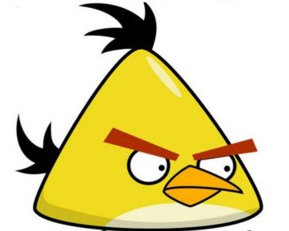
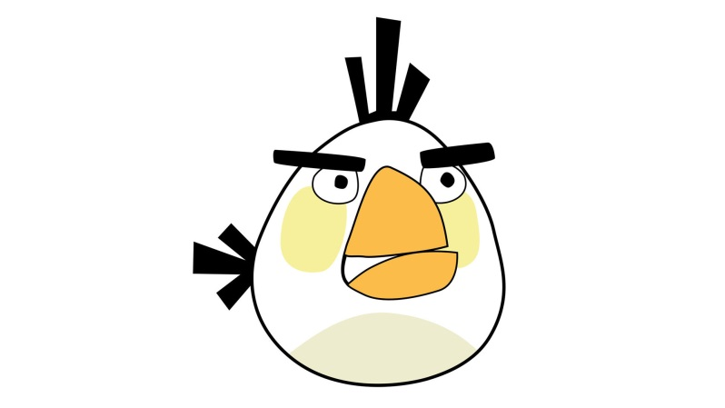
Anger and Bullying
Presented by:
Mrs. Rex

Slide 2
Why Are We Angry? Why Are We Mean?
Sad
Embarrassed
Frustrated
Hurt
Jealous
Lonely
Scared

Slide 3
When We Are Angry…
sometimes we make bad choices.
sometimes we hurt other people.
sometimes we hurt ourselves.

Slide 4
Staring, Making Faces

Slide 5
Saying Mean Words
!!!

Slide 6
Screaming, Hitting

Slide 7
Throwing Things

Slide 8
It’s Okay to Be Angry
It’s not okay to hurt other people.
It’s not okay to hurt yourself.
It’s not okay to hurt your school.

Slide 9
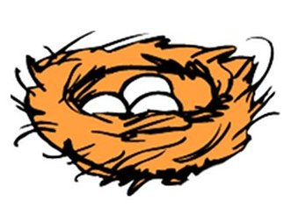
Quiet, Calm Place

Slide 10
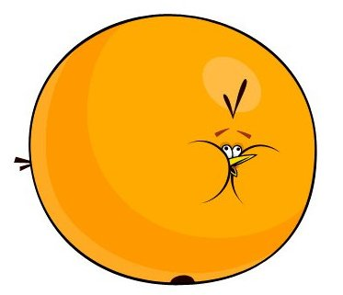
Deep Breaths

Slide 11
Stop and Think

Slide 12
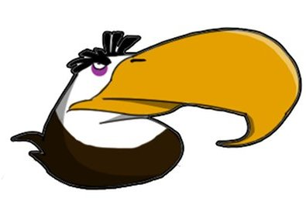
Adult Help

Slide 13
Other Ideas?
How do you make good choices?

